Slide 1
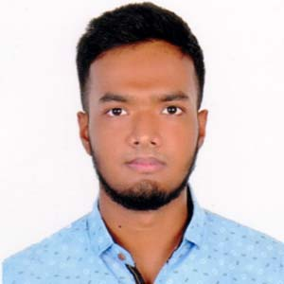



About me
I am a student of faculty of computer science and
Engineering,University of Patuakhali Science and Technology.
Education
2017
S.S.C with GPA 4.64 from Patuakhali Government Jubilee High School,Patuakhali.
Rakibul Islam Rehan
Student of Computer Science and Engineering
2019
H.S.C with GPA 5.00 from Patuakhali Government Collage, Patuakhali.
Professional Skills
Address
C++
Present Address
Java
Girls’ school road, Patuakhali Sadar,Patuakhali.
HTML
CSS
Permanent Address
Javascript
Girls’ school road, Patuakhali Sadar,Patuakhali.
Personal Skills
Contact
Team Work
Creativity
01796294755
https://codeforces.com/profile/Muku28
https://github.com/Rehan28/Rehan28
Networking
Leadership

Slide 2
Thank for watching sir.

